Slide 1
Has anyone heard about | CRYPTO CURRENCIES?
Question

Slide 2

Awesome Crypto-Currency Portfolio Tracker
Josh Steward, Fiona Wen, Cel Agdeppa, Khai Phan
Notes:
To use this title animation slide with a new image simply 1) move the top semi-transparent shape to the side, 2) delete placeholder image, 3) click on the picture icon to add a new picture, 4) Move semi-transparent shape back to original position, 5) Update text on slide.

Slide 3
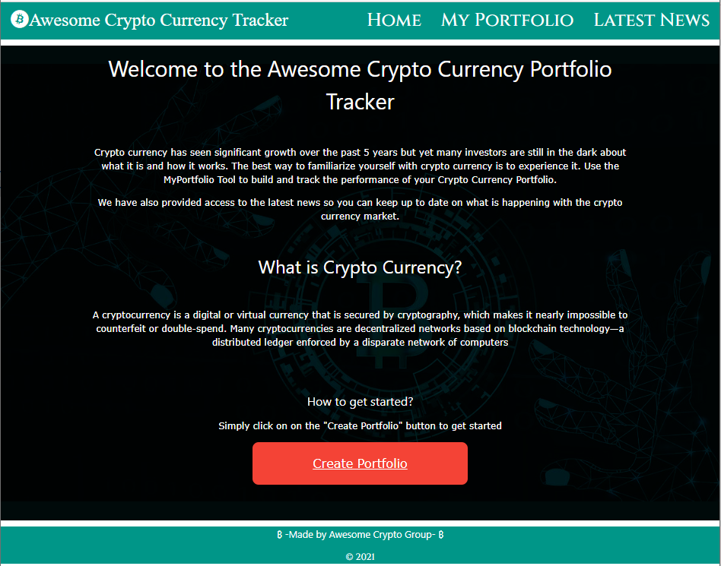
DESCRIPTION
Enable a prospective investor to build a mock portfolio of crypto currencies:
Select coins from the top 10 by market size
Obtain current prices, market size and latest performance
Assemble a mock portfolio and track your profit or loss
Access the latest news on crypto currencies

Slide 4
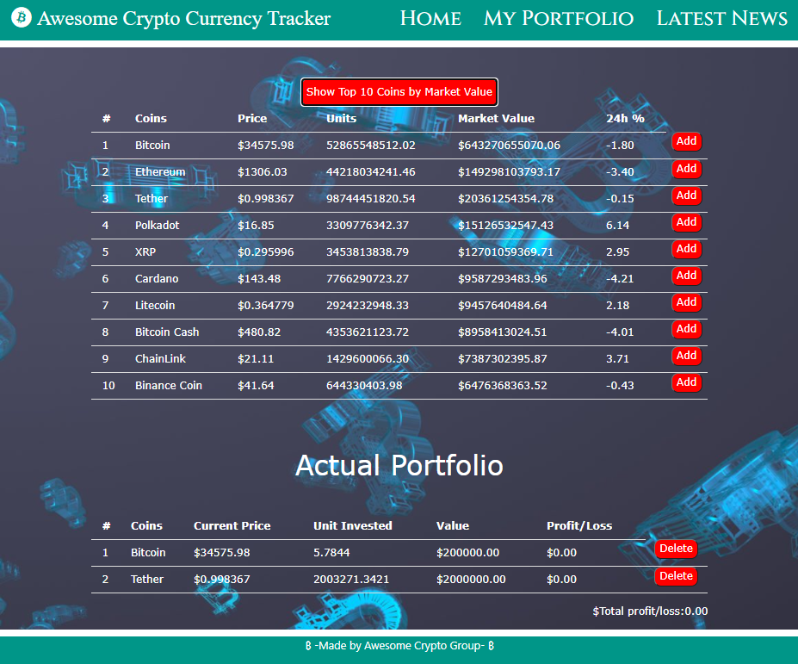
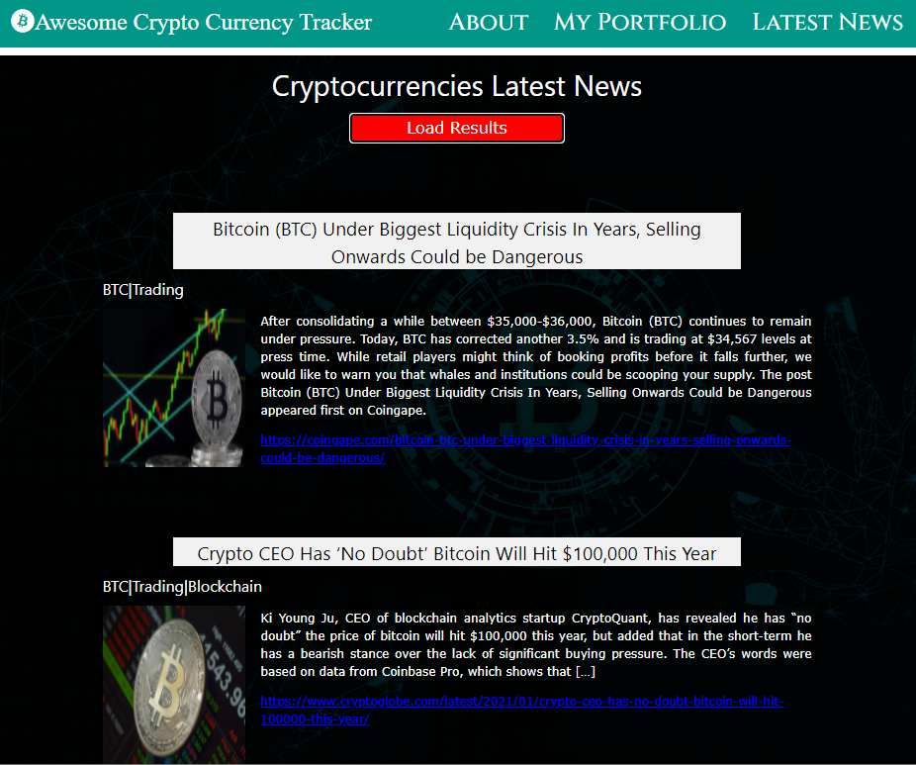
User story
“As an investor I would like to create and track a mock portfolio of crypto currencies to experience how it works.”
“I would like be up to date with the latest news on crypto currencies.”

Slide 5
TECHNOLOGIES USED
JS Library
APIs
CSS Framework & Styling
APIs utilized
https://www.cryptocompare.com/api#
https://www.coinlore.com/cryptocurrency-data-api
W3.CSS
<link rel="stylesheet" href="https://www.w3schools.com/w3css/4/w3.css">
Font awesome
jQuery

Slide 6
TASKS
Division of labour
User Interface & Styling
Cel Agdeppa
Portfolio Tracker Tables
Fiona Chenxu Wen
News API
Josh Steward
Project Management
Khai Phan

Slide 7
CHALLENGES
GitHub
Integration of separate files
Limited time-frame and coding knowledge
Learning how to operate GitHub to pull, push and merge requests for multiple users
Working on separate files and linking them together
With a short time-frame and being new to coding made some tasks a bit challenging

Slide 8
SUCCESSES
It works!!
Playing to our strengths
Learning valuable skills and knowledge
The app is functional based on our original design
Each team member had different strengths and we harnessed this
Each team member gained valuable skills and experience

Slide 9
DEMO

Slide 10
FUTURE
Directions for future development
More Coins
Expand the scope to include more than the top 10 coins by market size
Graphical presentation
Show past performance in graphical format
Integration with trading platforms
Enable investors to trade on crypto currencies with links to direct trading platforms

Slide 11
LINKS
GitHub repository
https://github.com/KhaiTPhan/AwesomeCryptoTracker
Application
https://khaitphan.github.io/AwesomeCryptoTracker/

Slide 12
THANK YOU!

